Slide 1

DICTIONARY WEB APPLICATION
TEAM MEMBER:-
SHYAM JI GUPTA SUBMITTED TO:-
HIMANSHU UPMANYU MISS NEELAM SONI
MANINDRA DWIVEDI

Slide 2
DICTIONARY WEB APPLICATION
The Dictionary Project is a non-profit organization that aims to improve literacy levels among children by providing them with their own personal dictionaries. The main objective of the project is to promote literacy and education by giving children the tools they need to become successful readers, writers, and communicators.
The Dictionary Project started in 1995 in South Carolina and has since expanded to other states in the US, as well as other countries around the world. The project has distributed millions of dictionaries to children, and continues to work towards its objective of improving literacy levels and promoting education..

Slide 3
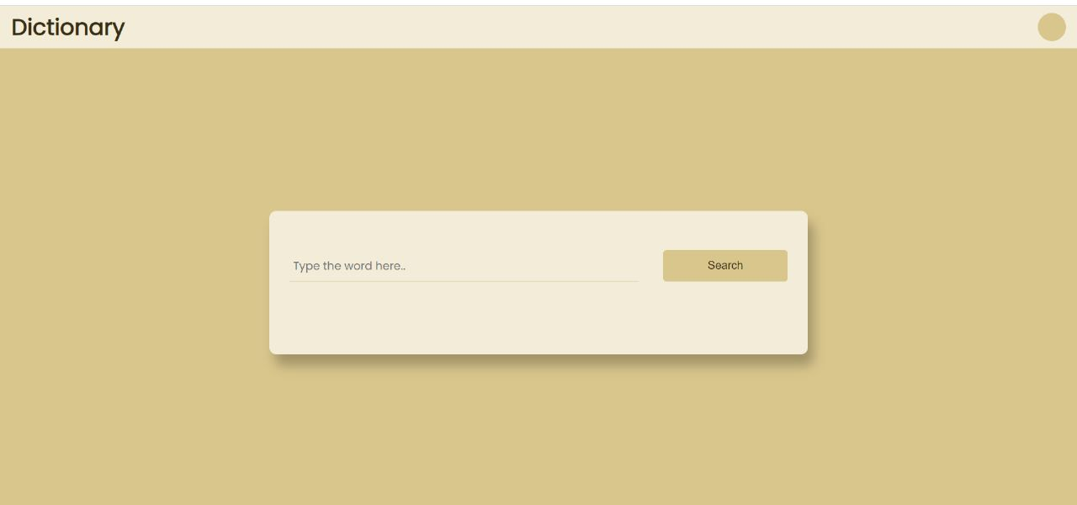
User Interface

Slide 4
Benefits of Dictionary
A dictionary can be used to look up the meaning of a word.
You can also use a dictionary to check the spelling of a word.
Dictionaries may also give other information about words, such as word type and word origin.
Grammatical information. A good dictionary will give grammatical information about each
word. ...
Spelling. ...
Pronunciation. ...
Other information.

Slide 5
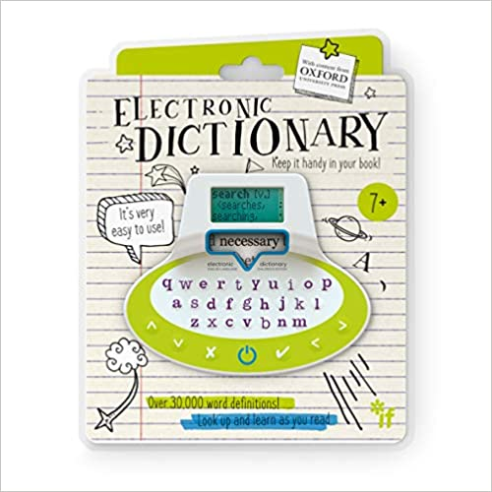
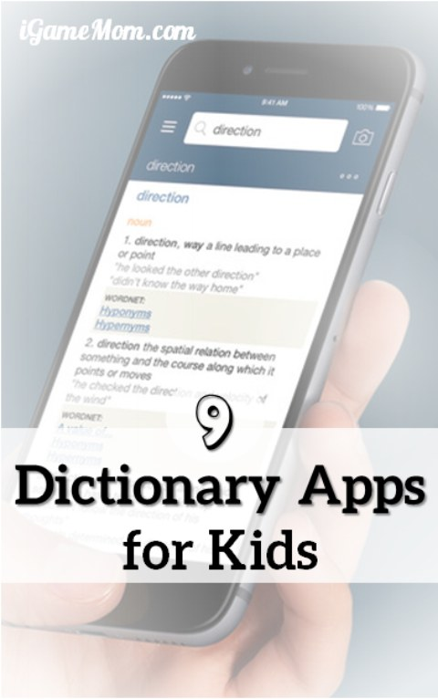
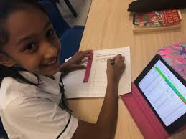
Different Facility Provide by Our Website

Slide 6
Software and Hardware Use
Window 11
VS Code
PHP Storm
XAMPP Control Panel (For store the customer details in our database(My SQL) )
8GB RAM
512 SSD
Google Chrome (To Run our Code)

Slide 7
How it Works
Firstly, Type a WORD in Search Bar
Then you will find the meaning of the Word
You also find the Word which is used in a particular Search
If you find a word which means no meaning than it will show Couldn’t Find the word.

Slide 8
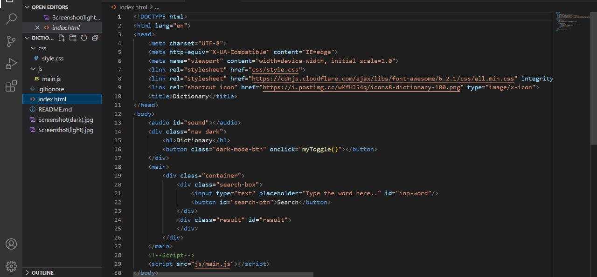
Home Page of our Website Code

Slide 9
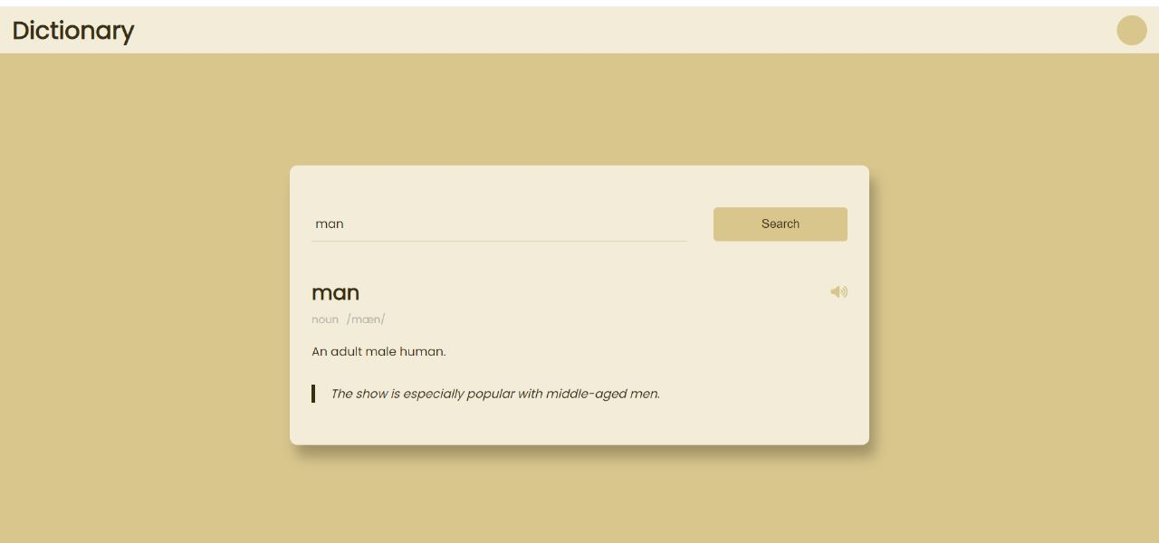
Home Page of Website

Slide 10
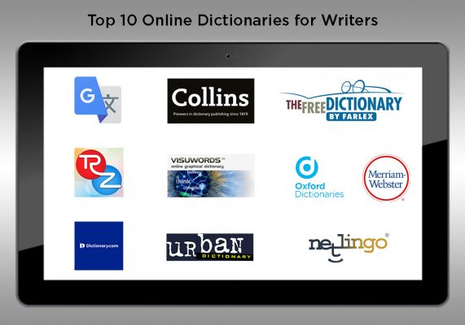
Various Famous Dictionary

Slide 11
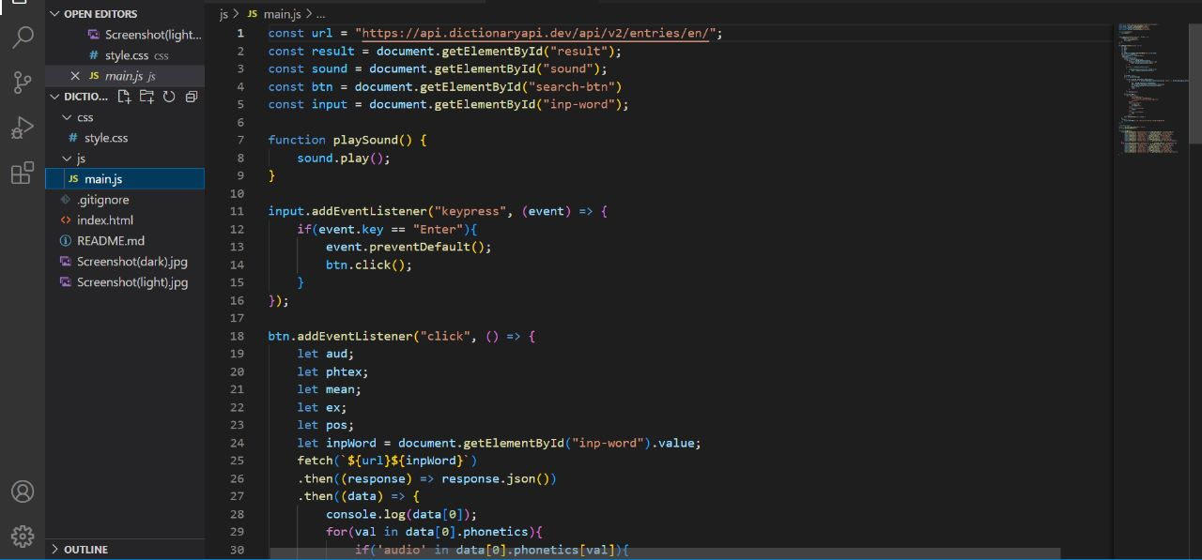
Use of Dictionary API

Slide 12
THANK YOU

